Slide 1

Manual Testing
Mr. Ranjit Kumbhar

Slide 2
What is the software?
Software is a collection of computer programs that helps us to perform a task.
Types of software:
1. System Software (e.g., Device drivers, OS, servers, etc.)
2. Programming Software (e.g., compilers, debuggers, interpreters, etc.)
3. Application Software (e.g., Web Applications, Mobile Apps, Desktop Applications, etc.)
What is Software Testing?
1. Software Testing is a part of the software development process.
2. Software Testing is an activity to identify the bugs in the software.
3. The objective/motive of testing is to release quality products to the client.
4. To ensures the client about the correctness and completeness of the software application.
Necessity of Software Testing:
1.
2.
3.
To avoid risks (prevent)
To identify errors (detect)
To avoid extra costs
4. To gain customer confidence
5. To accelerate software development
6. To optimize business
7. To check software adaptability
Objectives/Motive of Software Testing:
1.
To prevent defects.
2. Finding defects that may get created by the programmer while developing the software.
3. Helps to provide a quality product.
4.
To ensure that it satisfies the BRS and SRS.
5. To ensure that the result meets the business and user requirements.
6. Gaining confidence and providing information about the level of quality.

Slide 3
What is Debugging:
1. Once the Development team receives the testing team’s report, they will start debugging. This
phase aims to locate the bug and remove it from the software. It is a one-off process and is done
manually.
2. In this process, a special tool called a debugger is used in locating the bugs, most programming
environments have the debugger.
3. Some popular Debugger tools: WinDbg, OllyDbg, IDA Pro...
What is the difference between Testing and debugging?
•
Testing means checking the behavior of the application whether it is expected or not. And Testing can be done without any internal knowledge of software architecture. It’s done by a tester. Debugging means finding out the main cause of defects and debugging requires Internal
knowledge of the software architecture and coding. It’s done by the developer.
•
What defines (the quality of software) Software Quality:
1.
Bug-free
2. Delivered on time 3. Within budget 4. Meets the requirements and/or expectations of the customer 5. Maintainable
Psychology of testing:
• • •
In software testing, psychology plays an extremely important role. It is one of those factors that stay behind the scenes but has a great impact on the end result. It is mainly dependent on the mindset of the developers and testers, as well as the quality of communication between them. Moreover, the psychology of testing helps them work towards a common goal. The three sections of the psychology of testing are:
•
o The mindset of Developers and Testers. o Communication in a Constructive Manner.
o
Test Independence.
QA Vs. QC:
3P’s: Every Company has 3 Pillars:

Slide 4
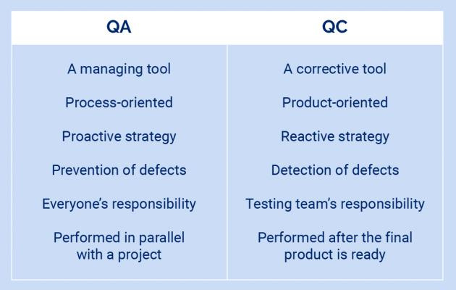
• • •
P - People (QC - Testers)
P - Process (QA - Involves throughout development/SDLC process.)
P - Product
Quality Assurance:
•
•
•
•
•
QA is process-oriented.
QA is a proactive process.
QA focuses on preventing defects.
QA team works with the development team to produce quality software.
QA ensures that approaches and techniques are implemented correctly (during software
development).
QA is responsible for SDLC.
E.g., Verification
•
•
Quality Control:
•
•
•
•
•
QC is product-oriented.
QC is a reactive process.
QC focuses on identifying/detecting the defects.
QC comes into the picture after Quality Assurance.
QC verifies that the developed project meets the defined quality standards.

Slide 5
• •
QC is responsible for STLC. E.g., Validation
QE (Quality Engineering):
•
•
Quality Engineer writes the code but for the software testing purpose.
Quality Engineers are nothing but Automation Testers.
What is QAMS?
•
A quality management system is a collection of business processes focused on consistently meeting customer requirements and enhancing their satisfaction. It is aligned with an organization's purpose and strategic direction. A quality management system (QMS) is a system that documents the policies, business processes, and procedures necessary for an organization to create and deliver its products or services to its customers, and therefore increase customer satisfaction through high product quality.
•
Capability Maturity Model (CMM-Levels):
It has long been accepted that continuous process improvement is based on many small
evolutionary steps rather than larger revolutionary innovations. The Capability Maturity Model
(CMM) provides a framework for organizing these evolutionary steps into five maturity levels that
lay successive foundations for continuous process improvement.
This methodology is at the heart of most management systems which are designed to improve
the quality of the development and delivery of all products and services.
The five Software Capability Maturity Model levels have been defined as:
1.
Initial The software process is characterized as ad hoc, and occasionally even chaotic. Few
processes are defined, and success depends on individual effort and heroics.
Repeatable
Basic project management processes are established to track cost, schedule, and
functionality. The necessary process discipline is in place to repeat earlier successes on
projects with similar applications.
2.

Slide 6
3. Defined
The software process for both management and engineering activities is documented,
standardized, and integrated into all processes for the organization. All projects use an
approved version of the organization’s standard software process for developing and
maintaining software.
4. Managed
Detailed measures of the software process and product quality are collected. Both the
software process and products are quantitatively understood and controlled.
5. Optimizing
Continuous process improvement is enabled by quantitative feedback from the process
and from piloting innovative ideas and technologies.
=============================================================================
Project Vs. Product:
•
If a software application is developed for a specific customer based on their requirement, then it
is called a Project.
If a software application is developed for multiple customers based on the market requirements,
then it is called a Product.
•
7 Principles of Software Testing:
1. Testing shows the presence of defects, not their absence
2. Exhaustive testing is impossible
3.
Absence-of-errors is a fallacy
4. Early testing saves time and money
5.
Testing is context-dependent
6. Defects cluster together
7. Beware of the pesticide paradox
✓
BETA DET
1.
Testing shows the presence of defects, not their absence:

Slide 7
•
Testing can show that defects are present but cannot prove that there are no defects. Testing reduces the probability of undiscovered defects remaining in the software, but testing is not proof of correctness even if no defects are found.
2.
Exhaustive testing is impossible:
•
Testing everything (all combinations of inputs and preconditions) is not feasible except for trivial cases.
Rather than attempting to test exhaustively, risk analysis, test techniques, and priorities
should be used to focus test efforts.
•
3.
Early testing saves time and money:
•
To find defects early, both static and dynamic test activities should be started as early as possible in the software development lifecycle.
Testing early in the software development lifecycle helps reduce or eliminate costly changes.
•
4.
Absence-of-errors is a fallacy
•
Some organizations expect that testers can run all possible tests and find all possible defects,
but this is impossible. It is a fallacy (i.e., a wrong belief) to expect that just finding and fixing a
large number of defects will ensure the success of a system.
For example, testing all specified requirements and fixing all defects found could still produce a system that is difficult to use but does not fulfill the users’ needs and expectations.
•
5.
Testing is context-dependent
• •
Testing is done differently in different contexts. For example, testing in an Agile project is done differently than testing in a sequential software development lifecycle project.
6.
Defects cluster together
•
This is the idea that certain components or modules of software usually contain the most number of issues or are responsible for most operational failures.
Testing, therefore, should be focused on these areas.
•
7.
Beware of the pesticide paradox

Slide 8
•
If the same tests are repeated over again and again, eventually these tests no longer find any new defects. To detect new defects, existing test cases and test data may need changing, and new tests
may need to be written.
Tests are no longer effective at finding defects, just as pesticides are no longer effective at
killing insects after a while. In some cases, such as automated regression testing, the pesticide
paradox has a beneficial outcome, which is the relatively low number of regression defects.
•
•
=============================================================================
SDLC - Software Development Life Cycle:
•
•
•
•
SDLC is a process used by the software industry to design, develop and test software.
SDLC process aims to produce high-quality software that meets customer expectations.
The software development should be complete in the pre-defined time frame and cost.
SDLC consists of a detailed process that explains how to plan, build, and maintain specific
software.
Why is SDLC Needed?
Here, are prime reasons why SDLC is important for developing a software system.
✓
✓
It provides a standard set of frameworks for SDLC activities.
✓
SDLC is helpful for project tracking and control.
✓
Increased and enhanced development speed.
✓
Helps you to decrease project risk and project management plan overhead.
Increases visibility of project planning to all involved stakeholders of the development
process.
✓
✓
Improved client relations.
It offers a basis for project planning, scheduling, and estimating.
Phases in SDLC:
1. Requirement Gathering and Analysis
2. Design
3. Coding (Development/Implementation)
4.
Testing
5. Deployment / Installation
6. Maintenance

Slide 9
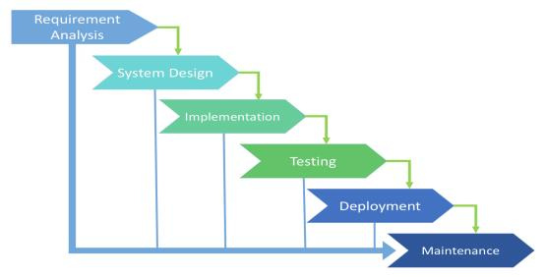
RDC-TDM
1. Requirement Analysis:
•
We have to collect and understand the requirement of the customer. Normally BA’s, Project
Managers, and Product Managers are involved in this phase.
They will talk to the customer, get the requirements, and prepare a certain number of
documents (BRS/SRS).
This stage gives a clearer picture of the scope of the entire project and forecasts issues.
This helps companies to finalize the necessary timeline to finish the work of that system.
•
•
•
2. Design:
•
•
This helps to define the overall system architecture.
In this phase, both system and software design documents are prepared as per the
requirement specification document.
This design phase serves as input for the next phase of the model.
It contains documents like DDS (Design Document Specification) OR TDD (Technical Design
Document).
There are two kinds of design documents developed in this phase:
•
•
•
✓
a. High-Level Design (HLD):
✓
Brief description and name of each module.
✓
An outline of the functionality of every module.
✓
Integration between modules.
✓
Database tables are identified along with their key elements.
Complete architecture diagrams along with technical details.

Slide 10
b.
Low-Level Design (LLD):
✓
✓
Actual Functional logic of the modules.
✓
Complete input and outputs for every module.
✓
Complete details of the integrations/interfaces.
✓
Addresses all types of dependency issues.
✓
List of error messages.
Database tables, which include type and size.
3.
Coding:
•
Once the system design phase is over, the next phase is coding. In this phase, developers start to build the entire system by writing code using the chosen programming language.
In the coding phase, tasks are divided into units or modules and assigned to the various
developers.
It is the longest phase of the Software Development Life Cycle process.
In this phase, the developer needs to follow certain predefined coding guidelines.
They also need to use programming tools like compilers, interpreters, and debuggers to
generate and implement the code.
•
•
•
•
4.
Testing:
•
Once the software is complete, it is deployed in the testing environment. The testing team starts testing the functionality of the entire system. This is done to verify that the entire application works according to the customer’s requirements. During this phase, QA and testing team may find some bugs/defects which they communicate
to developers. Then development team fixes the bug and sends it back to QA for a retest. This
process continues until the software is bug-free, stable, and working according to the business
needs of that system.
•
5.
Deployment / Installation:
•
Once the software testing phase is over and no bugs or errors are left in the system then the
final deployment process starts. Based on the feedback given by the project manager, the
final software is released and checked for deployment issues if any.
6. Maintenance:

Slide 11
•
Once the system is deployed, and customers start using the developed system, the following three activities may occur:
✓
Bug fixing - Bugs are reported because of some scenarios which are not tested
at all.
✓
✓
Upgrade - Upgrading the application to the newer versions of the Software.
Enhancement - Adding some new features to the existing software.
=============================================================================
Which SDLC model is best?
•
There is no model that we can consider as the best for software development process. But
nowadays the
Agile model is currently the most popular and widely used by all the software organization. In
this model after
every development stage (Sprint), the user is able to see whether the product meets his
requirements. By this
way the risks are reduced as continuous changes are done depending on client’s feedback.
•
•
•
=============================================================================

Slide 12
Types (Models) of SDLC: 1. Waterfall Model
2. Spiral Model
3. Rapid Application Development (RAD) Model
4. Iterative or Incremental Model
5. Prototype Model
6. V Model
7. Agile Model
1. Waterfall Model:
•
Waterfall is one of the earliest and most commonly used software development models
(processes), in which the development process looks like the flow, moving step by step
through the phases like analysis, design, coding, testing, deployment/installation, and
support. So, it is also known as the “Linear Sequential Model”.
This SDLC model includes gradual execution of every stage completely. This process is
strictly documented and predefined with features expected for every phase of this
software development life cycle model.
•
Advantages of Waterfall Model:
1. Simple, easy to understand, and use. 2. Easy to implement because of its linear process. 3. Since requirement changes are not allowed, the chances of finding bugs will be less.

Slide 13
4. 5.
Initial investment is less since the testers are hired at the later stages. Preferred for small projects where requirements are frozen (well understood at an early stage).
Disadvantages of Waterfall Model:
1. Requirement changes are not allowed. 2. If there is a defect in the Requirement that will be continued in later phases. 3. Poor model for a long and ongoing project. 4. Testing will start only after the coding phase. 5. Total investment is more because if the rework was done due to defects, leads to
time-consuming and high investment.
Where we Use (Use Cases for) Waterfall SDLC Model:
1. The requirements are precisely documented.
2.
Product definition is stable.
3. The technologies stack is predefined which makes it not dynamic. 4. No ambiguous (doubtful) requirements.
5.
The project is short.
=============================================================================
2. Spiral Model: PREE
1. Spiral Model is also known as an iterative model.
2. It is a combination of the Prototype and Waterfall model.
3. Spiral Model is mostly used in high-risk projects (in large and complex projects).
4. It is used when the requirement is large also unclear and complex.
5. Spiral Model overcomes drawbacks of Waterfall Model.
6. It consists of 4 stages Planning, Risk Analysis, Engineering, and Evaluation.
7. In every cycle new software [module] version will be released to the customer.
8. Software will be released in multiple versions. So, it is also called a version control
model.

Slide 14
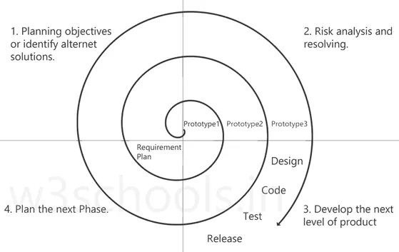
Stages:
1. Planning objectives or identifying alternative solutions: In this stage, requirements
are collected from customers, and then the aims are recognized and analyzed at the
beginning of developing the project. If the iterative round is more than one, then an
alternative solution is proposed in the same quadrant.
2.
Risk analysis and resolving: As the process goes to the second quadrant, all likely solutions are sketched, and then the best solution among them gets selected. Then the different types of risks linked with the chosen solution are recognized and resolved through the best possible approach. As the spiral goes to the end of this quadrant, a project prototype is put up for the most excellent and likely solution.
3.
Develop the next level of product: As the development progress goes to the third quadrant, the well-known and most required features are developed as well as verified with the testing methodologies. At the end of this third quadrant, new software or the next version of existing software is ready to deliver.
4.
Plan the next Phase: As the development process proceeds in the fourth quadrant, the customers appraise the developed version of the project and report if any further changes are required. At last, planning for the next (subsequent) phase is initiated.

Slide 15
Prototype: A prototype is a blueprint of the software.
Initial requirements from the customer ---> PROTOTYPE ---> customer ---> Design, Coding,
Testing....
Advantages of Spiral Model:
1. Suitable for large projects: Spiral models are recommended when the project is large,
bulky, or complex to develop.
2. Risk Handling: There are a lot of projects that have un-estimated risks involved with them. For such projects, the spiral model is the best SDLC model to pursue because it can analyze risk as well as handle risks at each phase of development.
3. Customer Satisfaction: Customers can witness the development of the product at every stage and thus, they can let themselves habituate to the system and throw feedback accordingly before the final product is made.
4. Requirement’s flexibility: All the specific requirements needed at later stages can be
included precisely if the development is done using this model.
Disadvantages of Spiral Model:
1. Requirement changes are NOT allowed in between the cycle. 2. Every cycle of the spiral model looks like a waterfall model. 3. There is no testing in the requirement and design phase. 4. Does not work for smaller projects.
5.
It can be quite expensive.
=============================================================================
3.
RAD Model:
RAD stands for “Rapid Application Development”. As per the name itself, the RAD model is a
model to develop fast and high-quality software products by Requirements using workshops.
1.
Prototyping and early, reiterative user testing of designs.
2. The re-use of software components.
3. Less formality in reviews and other team communication.
=============================================================================
4.
Iterative Model:

Slide 16
1. In an iterative model application will get divided into small parts and development will be done by specifying and implementing only small parts of the software, which can be reviewed to identify further requirements.
2. This process is repeated, creating a new version of the software for each cycle of the model. The iterative model is very simple to understand and use. In this model, we can’t start developing the complete software with full specification of requirements
=============================================================================
5.
Prototype Model:
•
It is a trial version of the software. It is a sample product that is designed before starting
actual testing.
This model is used when user requirements are not very clear, and this software is tested
based on raw requirements obtained from the user. The available types of prototyping
are Rapid, Incremental, Evolutionary, and Extreme.
Prototype Model will work like --
1. We will take basic requirements
2. Based on the discussion, we will create an initial prototype (A prototype – is a working
•
•
model)
3. Once the working prototype is built, we will ask the client to check and use it
4. Next step will be to test and enhance
5. Again, we will call the user to check and use it, and again we will make changes as per
the user's feedback until we get all the requirements from the user.
6. Once, all requirements are fulfilled and the client will agree, then the last step will be
signed off (Sign off - Deliver the product and finish the contract)
Advantages of Prototype Model:
1. Users are actively involved in the development 2. Missing functionalities can be identified easily 3. Based on user feedback, the SRS document is finalized
Disadvantages of Prototype Model:
1. Sample model is not used for actual implementation 2. Scope of the system may expand beyond original plans
=============================================================================

Slide 17
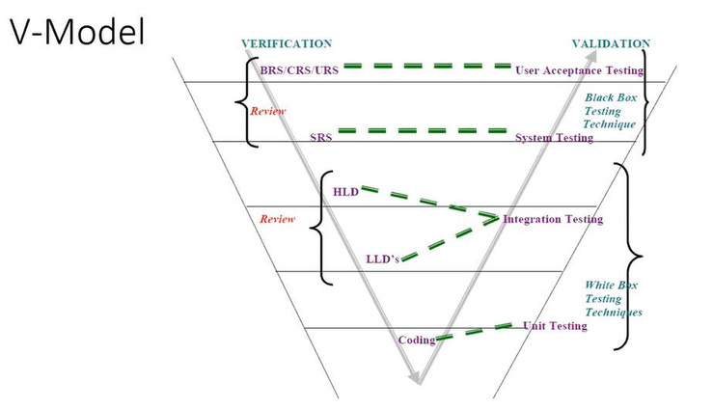
6.
V Model:
•
In parallel to the software development phase, a corresponding series of test phases also runs in this model. Each stage ensures a specific type of testing is done, and once that testing is passed, only then the next phase starts. When the requirement is well-defined and ambiguous (uncertain), we use V-Model. It is also known as Verification and Validation model.
• •
Verification: Design Phase:
1. Verification checks whether we are building the right product (software) (to check
whether the specific requirements will meet or not).
2. Focus on documentation. Testing the project-related documents are called static testing.
3.
4.
Verification does not involve the code execution.
Verification typically involves Static Testing techniques like:
✓
✓
Reviews
✓
Walkthroughs
5. There are the various phases of the Verification Phase in the V-model,
Inspections
i.
o This is the first step where product requirements are understood from
the customer's side. This phase contains detailed communication to
understand customers’ expectations and exact requirements.
BRS (Business Requirement Specification):
ii.
SRS (Software Requirement Specification):

Slide 18
o In this stage system engineers analyze and transfer the business of the proposed system to SRS by studying the user requirements document (BRS).
iii.
HLD (High-Level Design):
o
High-level design (HLD) explains the architecture that would be used to develop a system.
o The architecture diagram provides an overview of an entire system, identifying the main components that would be developed for the product and their interfaces.
iv.
LLD (Low-Level Design):
o In the module design phase, the system breaks down into small
modules.
o The detailed design of the modules is specified, which is known as Low-
Level Design
Coding Phase:
•
After designing, the coding phase is started. Based on the requirements, a suitable programming language is decided. There are some guidelines and standards for coding. Before checking in the repository, the final build is optimized for better performance, and the code goes through many code reviews to check the performance.
Validation: Testing Phase:
1. Validation checks whether we are building the product (software) right (to check whether
we are developing the right software).
2. Focus on software.
3.
Validation typically involves actual testing.
4. Takes place after verifications are completed. 5. Here we use the below Dynamic testing techniques:
✓
✓
Unit Testing
✓
Integration Testing
✓
System Testing
•
UAT
Advantages of the V Model:
1.
2. Every stage of the V-shaped model has strict results, so it is easy to control.
Testing is involved in each and every phase.
3.
4. Good for small projects, where requirements are static and clear.
5. Testing Methods like planning, test designing happens well before coding.
Testing and verification take place in the early stages.

Slide 19
•
Disadvantages of the V Model:
1. Documentation is more. 2. If any changes happen in the midway, then the test documents along with the
required documents, must be updated.
3. Initial investment is more.
4.
Very rigid and least flexible.
5. Software is developed during the implementation stage, so no early prototypes of the
software are produced.
When to use V Model:
1. The V-shaped model should be used for small to medium-sized projects where
2.
requirements are clearly defined and fixed. Experienced technical resources are available
Is Waterfall Model and V Model being the same.?:
V Model is the updated version of Waterfall Model.
=============================================================================
Static Testing Techniques:
We use Static Testing Techniques on the Verification side in V Model.
1. Review
2. Walkthrough
3.
Inspection
1.
Review: Review conducts on documents to ensure correctness and completeness.
•
•
•
•
•
Requirement reviews
Design reviews
Code reviews
Test Plan reviews
Test cases reviews etc.
2. Walkthrough:

Slide 20
• • • •
It is an informal review. It is not pre-planned and can be done whenever required. Author reads the documents or code and discusses it with peers. Also, the walkthrough does not have minutes of the meeting.
3.
Inspection:
• •
It is the most formal review type. Inspection will have a proper schedule which will be intimated via email to the concerned developer/testers.
In which at least 3-8 people sit in the meeting 1-reader, 2-writer, 3-moderator
plus concerned people.
•
Dynamic Testing Techniques:
We use Dynamic Testing Techniques on the Validation side in V Model. 1. Unit Testing
2.
3. System Testing
4. User Acceptance Testing (UAT)
Integration Testing
Why do we need testing in the SDLC process?
•
The testing phase is very important to check whether the developed software is a quality product and matches with a design document. This stage confirms that the developed product meets the requirements defined by clients. In this stage, we perform different types of tests including unit testing, acceptance testing, system testing, etc. The software testing team works together with developers to identify and resolve software bugs and provides the Quality Application to the client.
Explain the software release process in brief:
•
In the software release process, the project manager makes a release team consisting of developers, testers, project management executives. This team goes to customers’ places and deploys software products or they just deploy the software at the client’s server. The team also delivers some training to customers regarding the functioning of software if required.

Slide 21
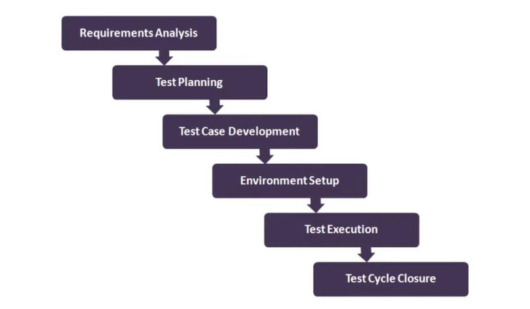
What is the difference between SDLC and STLC?
•
Software Development Life Cycle involves the complete Verification and Validation of a Process or a Project.
Whereas Software Testing Life Cycle involves only Validation.
•
=============================================================================
STLC - Software Testing Life Cycle:
DESCRIPTION
1. Requirement Analysis
2.
3. Test Design
4. Test Environment Setup
Test Planning
5.
6.
Test Execution
Test Closure

Slide 22
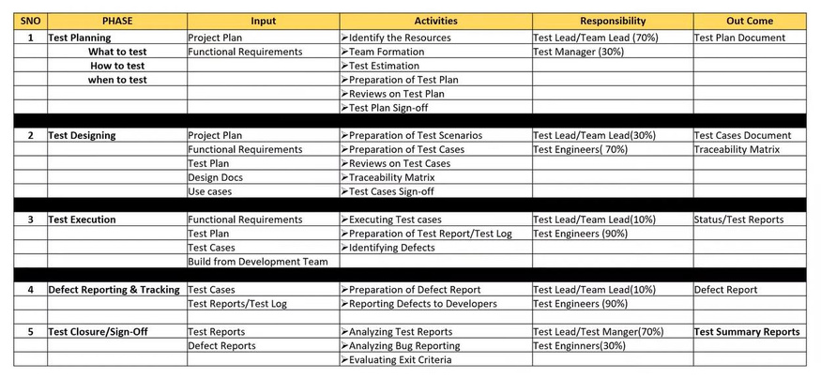
1.
Requirement Analysis: In this phase, the requirements documents are analyzed and validated, and the scope of testing is defined. Test Planning: In this phase, test plan strategy is defined, estimation of test effort is defined along with automation strategy and tool selection is done. Test Design: In this phase test cases are designed; test data is prepared, and automation scripts are implemented. Test Environment Setup: A test environment closely simulating the real-world environment is prepared. Test Execution: To perform actual testing as per the test steps. Test Closure: Test Closure is final stage of STLC where we will make all details documentations which are required submit to client at time of software delivery. Such as test report, defect report, test cases summary, RTM details, release note.
2.
3.
4.
5.
6.
=============================================================================
What is Test Closure?
Test Closure is final stage of STLC where we will make all details documentations which are required
submit to client at time of software delivery. Such as test report, defect report, test cases summary,
RTM details, release note.

Slide 23
What is the list of test closure documents?
It includes,
1. test case documents, (i.e., Test Case Excel sheet we prepare during actual testing)
2.
3.
4.
5.
test plan, test strategy,
Release note
test scripts,
test data,
6. traceability matrix, and
7.
test results and reports like bug report, execution report etc.
Explain about each of test closure documents?
1. test case documents: Include detail test cases that can be reviewed.
2.
test plan, test strategy: Included Entire Test planning, Strategies, Schedules Etc.
3. Release note: Includes all release related data like Software version, supporting hardware
details, known issues, closed issues, added features etc.
4. test scripts: It contain Scripts in terms of automation testing. 5. test data: It contains which date you were used while testing. 6. traceability matrix: traceability includes all pass and fail test cases matrix and defect records. 7. test results and reports like Bug Report and Execution Report: Test Results shows entire
summery on tested applications.
What is a Build?
•
It is a number/identity given to Installable software that is given to the testing team by the
development team
What is release?
•
It is a number/ identity given to Installable software that is handed over to the customer/client
by the testing team (or sometimes directly by the development team)
What is deployment?
•
Deployment is the mechanism through which applications, modules, updates, and patches are delivered from developers to end-user/client/customer.
When will actual testing start?

Slide 24
•
Testing includes many activities in each phase of the development life cycle as requirement analysis, creating test plan, test design, etc. So, software testing activity should be started as soon as possible (After requirement baseline) in the development life cycle.
Which tools you are using to write review test cases?
•
Generally, in our company we preferred to write down test cases in an excel sheet because it’s very easy and user-friendly. After completion of the review, we will add that test cases in TestLink for future tracking purposes. TestLink Version: -1.9.13 (Strombringer)
•
What is a different attribute of test cases?
1. TestCaseID - A unique identifier of the test case. 2. Test Summary - One-liner summary of the test case. 3. Description - Detailed description of the test case. 4. Prerequisite or pre-condition - A set of prerequisites that must be followed before executing
the test steps.
5. Test Steps - Detailed steps for performing the test case.
6. 7. 8.
Expected result - The expected result in order to pass the test. Actual result - The actual result after executing the test steps. Test Result - Pass/Fail status of the test execution.
9. Automation Status - Identifier of automation - whether the application is automated or not. 10. Date - The test execution date. 11. Executed by - Name of the person executing the test case.
What is the code freeze?
•
Code freeze means Finalization of code and no further changes will be happening in code.
How would you define that testing is sufficient and it’s time to enter the Test Closure phase? Or
when we should stop testing?
•
Testing can be stopped when one or more of the following conditions are met,
1. After test case execution – The testing phase can be stopped when one complete
cycle of test cases is executed after the last known bug fix with the agreed-upon value
of pass percentage.
2. Once the testing deadline is met - Testing can be stopped after deadlines get met
with no high priority issues left in the system.

Slide 25
3.
Based on Mean Time Between Failure (MTBF)- MTBF is the time interval between two inherent failures. Based on stakeholders’ decisions, if the MTBF is quite a large one can stop the testing phase. Based on code coverage value – The testing phase can be stopped when the automated code coverage reaches a specific threshold value with sufficient pass percentage and no critical bug.
4.
What is your (QA/Tester) basic roles and responsibility?
• • • • • • • •
Understanding & analyzing Test Requirements. Prepare Test Scenarios for individual modules. Writing & review the Test Cases as per requirements. Test cases execution. Defect creation, Defect verification, and QA task management. Weekly Test status reporting. Continuous Communication with the team & client. Preparation of Test Plan Documentation (if have 3+ years exp).
How to write effective test cases?
•
Effective test cases have been considered
1. Test cases should be simple to understand which helps to review and retest. 2. Test cases should focus on end-user requirements.
3. 4. 5. 6.
Test cases should be able to find defects. Test cases should contain proper steps and test data. Test cases should be Re-usable Test cases should express expected and actual results.
Mention what are the types of documents in QA?
• • • • • • • • • •
The types of documents in QA are Requirement Document Test Metrics Test cases and Test plan Task distribution flow chart Transaction Mix User profiles Test log User profiles Test incident report

